Slide 1
Software Design Principles
Yogesh Naik

Slide 2
Agenda
SOLID
Law of Demeter (Principle of Least Knowledge / Tell Don’t Ask)
DRY (Do not Repeat Yourself)
YAGNI (You Ain’t Gonna Need It)

Slide 3
SOLID Principles
The principles are a subset of many principles promoted by Robert C. Martin (Unble Bob)
Term is coined by Michael Feathers
S – Single Responsibility Principle (SRP)
O – Open and Close Principle (OCP)
L – Liskov Substitution Principle (LSP)
I – Interface Segregation Principle (ISP)
D – Dependency Inversion Principle (DIP)

Slide 4
S – Single Responsibility Principle (SRP)
A method or class should have one and only one responsibility.
How to find out how many responsibilities a method or class is having?
A method or class should have only one reason to change.
A method or class should be at one level of abstraction.
A method or class should be highly cohesive.

Slide 5
Same level of abstraction
All the statements in a method should be at one level of abstraction.
void compute() { input(); flags|= 0x0080; output(); }
If the statements are not at one level of abstraction extract them in methods with meaningful names.
Methods having one abstraction level are likely to do one thing.
Too much indentation in a method is a dead giveaway that the method is doing things at different levels of abstraction.
FallOutWriter.readableFileLines()
Try/catch blocks with more than one statement in try and/or catch blocks.

Slide 6
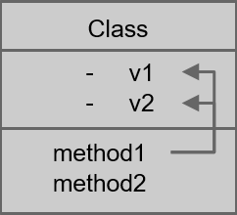
SRP for Classes
How to identify if a class is following SRP?
Classes should have a small number of instance variables.
More variables a method manipulates the more cohesive that method is to its class.
The more cohesive the methods are the more cohesive the class will be.
We want the classes to have high cohesion.
Highly cohesive classes follow SRP
When classes lose cohesion, split them!
FallOutWriter.readableFileLines()
CreateFeatureEdit.removeUnwantedAttributeTypes()

Slide 7
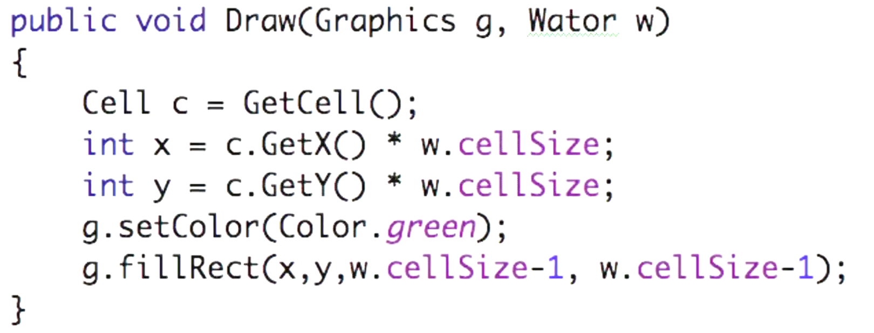
SRP Method Example
Draws Cell as Green rectangle on screen
Also translates co-ordinates

Slide 8
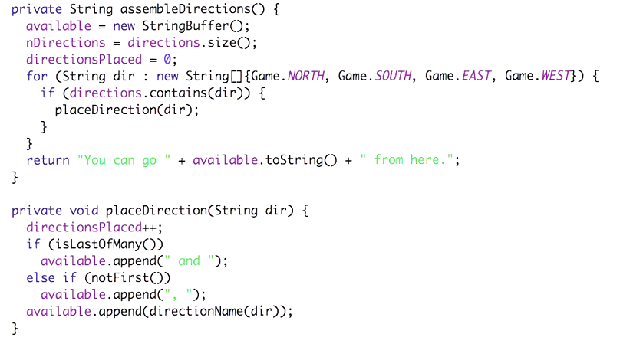
SRP Method Example
Creates list of “available” directions
Builds a message about “available” directions

Slide 9
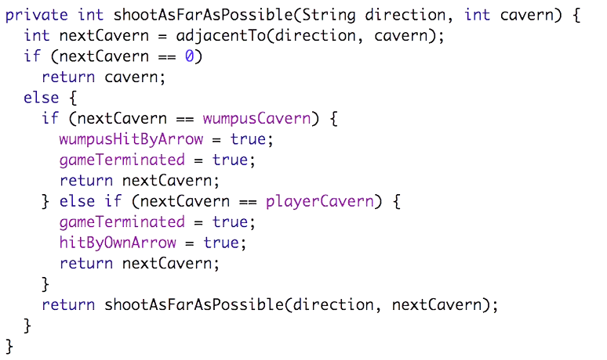
SRP Example
Follows the arrow recursively
Also it “terminates” the game

Slide 10
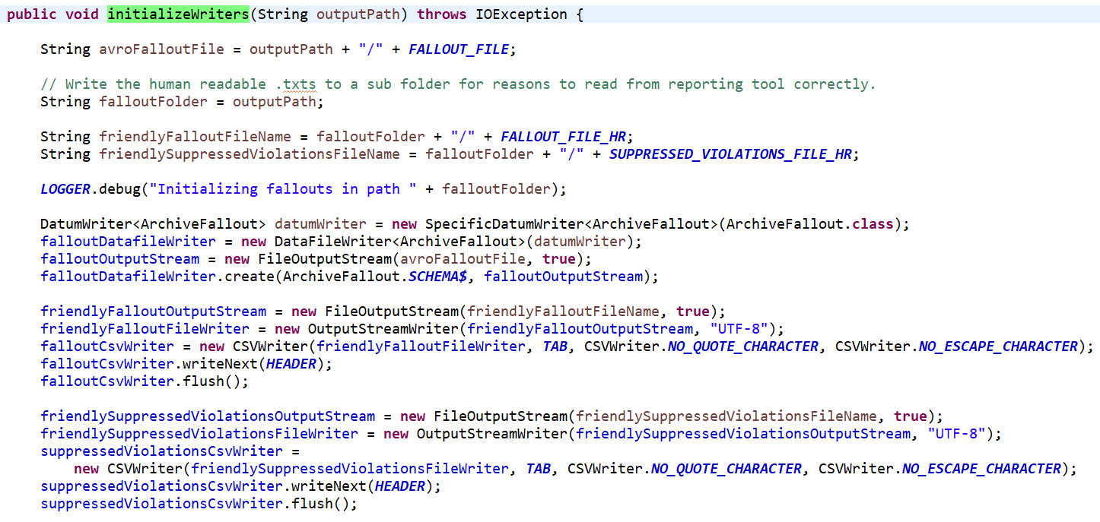
SRP Example
Let us see how to fix this method to follow SRP
Calculates the various file paths
Initializes different file writers
Writes header line to file

Slide 11
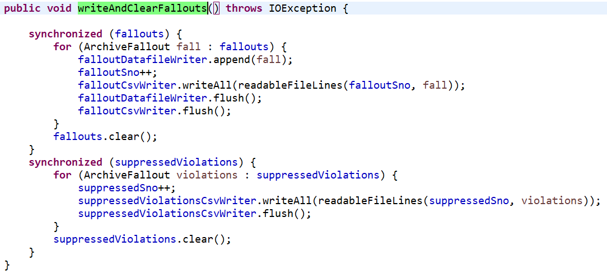
SRP Example
Writing Fallouts (CSV and Avro files)
Writing suppressed violations
Calculating next Serial number?

Slide 12
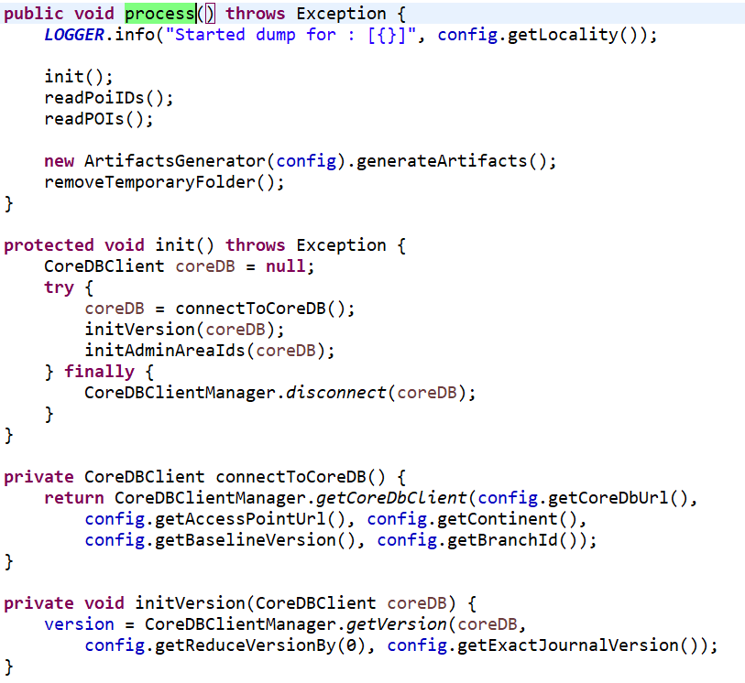
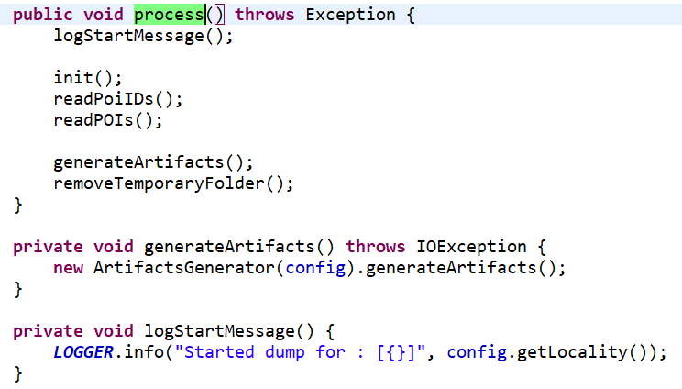
SRP Example
process()
Apart from logging start message and creating ArtifactsGenerator instance, it is doing only delegation
Not even doing error handling
init()
Doing only delegation
connectToCoreDB()
Doing only delegation
initVersion()
Doing only delegation

Slide 13
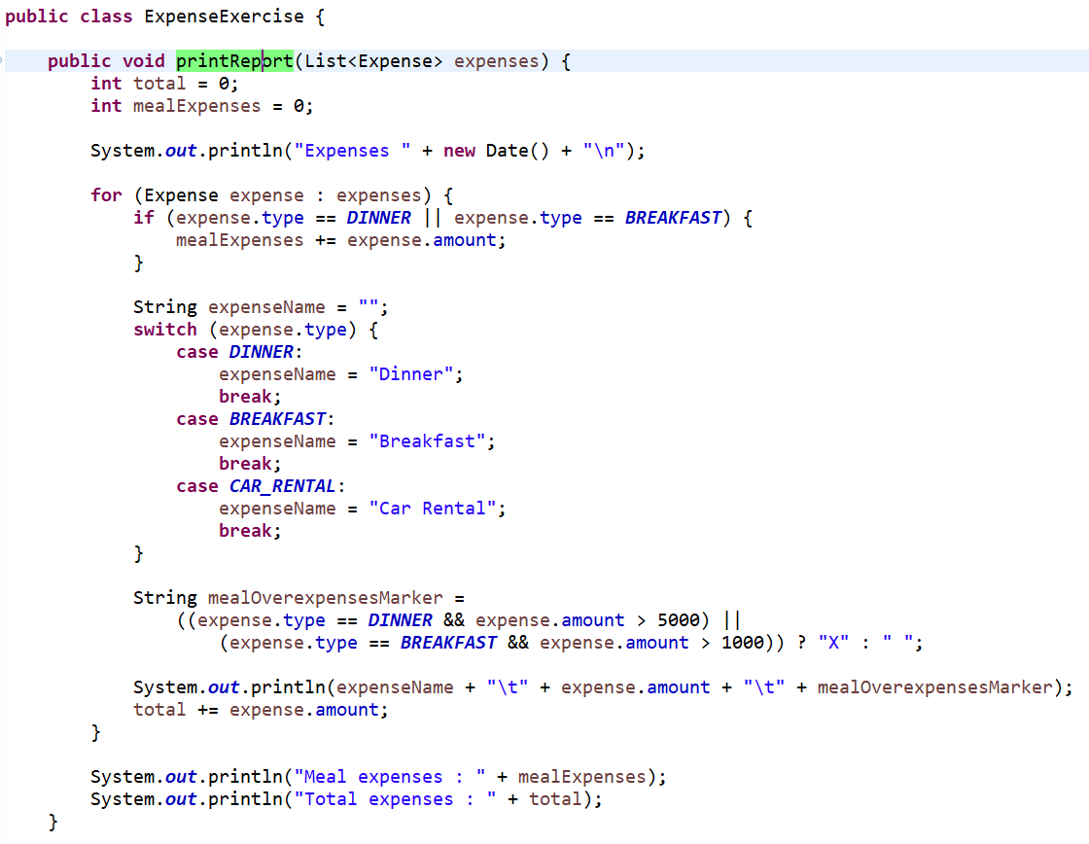
SRP Method Example
Calculating totals
Printing report
Prints Header
Prints each Expense
Prints Totals
Formatting of expense
Decides Meal Overclaim

Slide 14
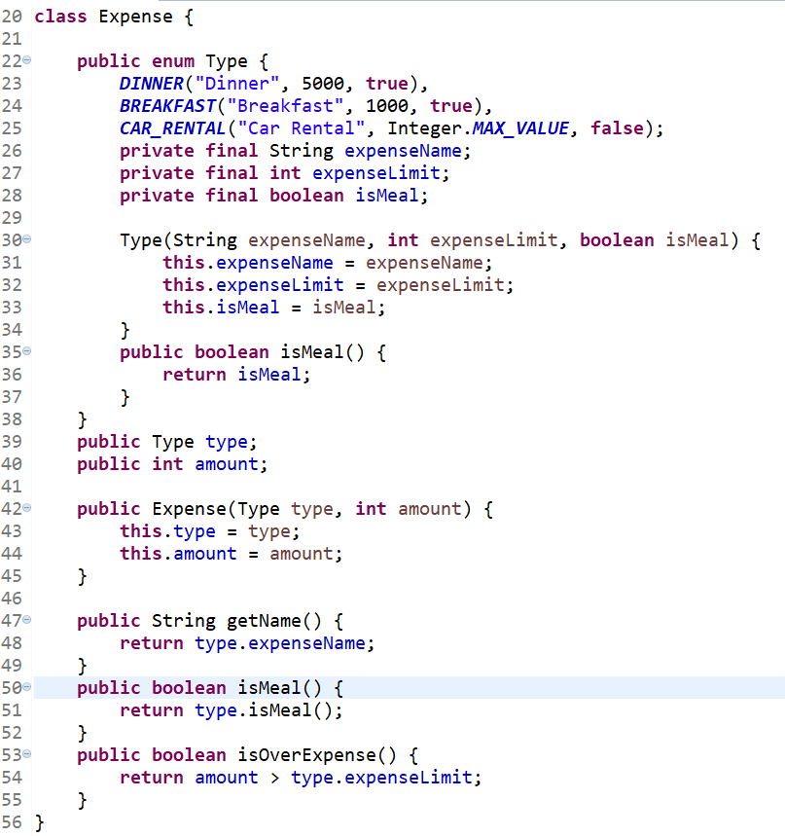
SRP – Expense Solution

Slide 15
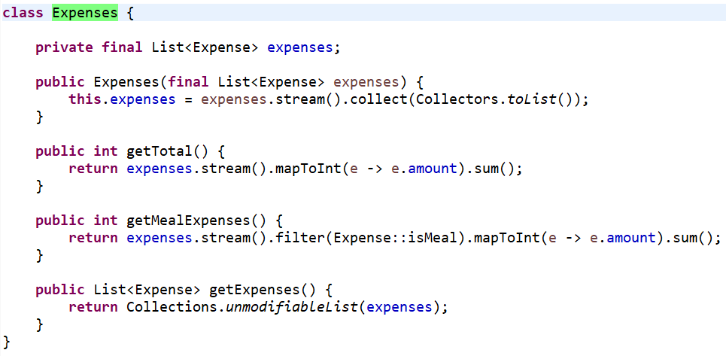
SRP – Expense Solution

Slide 16
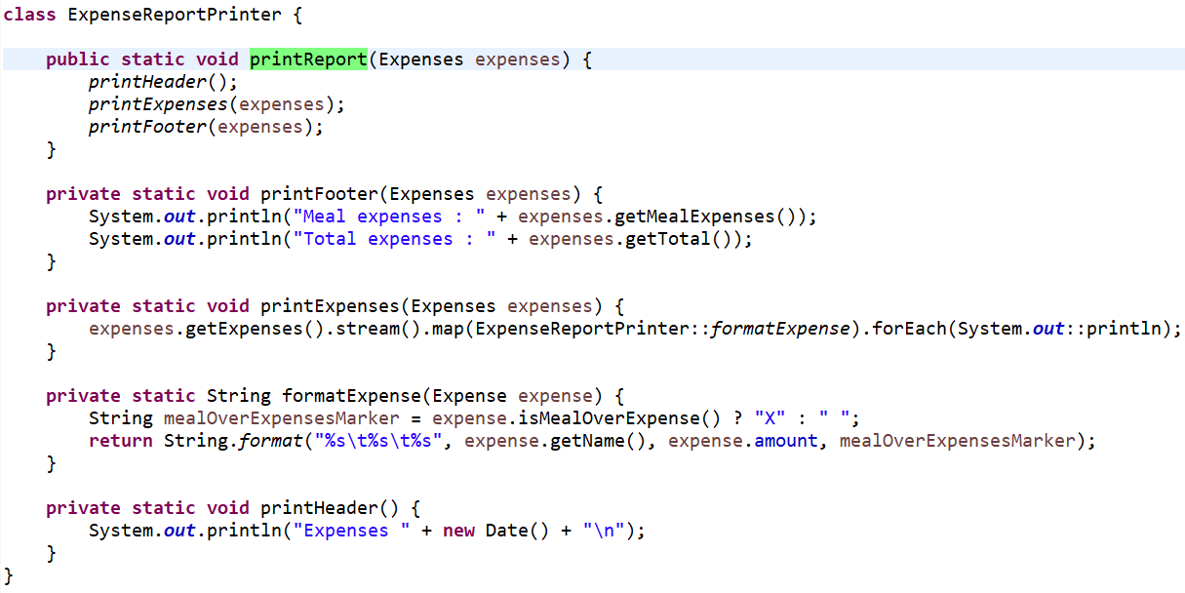
SRP – Expense Solution

Slide 17
SRP Method Example
ImporterService – SRP
After fix
ImporterService
BatchService

Slide 18
SRP
Is Logging a responsibility?
Who are actors that will request change in Log statements?
How can you separate it out form the code that is being logged?
Is Timing a method invocation a responsibility?
How can you separate it out form the method that you want to time?
Is Error handling a responsibility?
How can you separate it out?

Slide 19
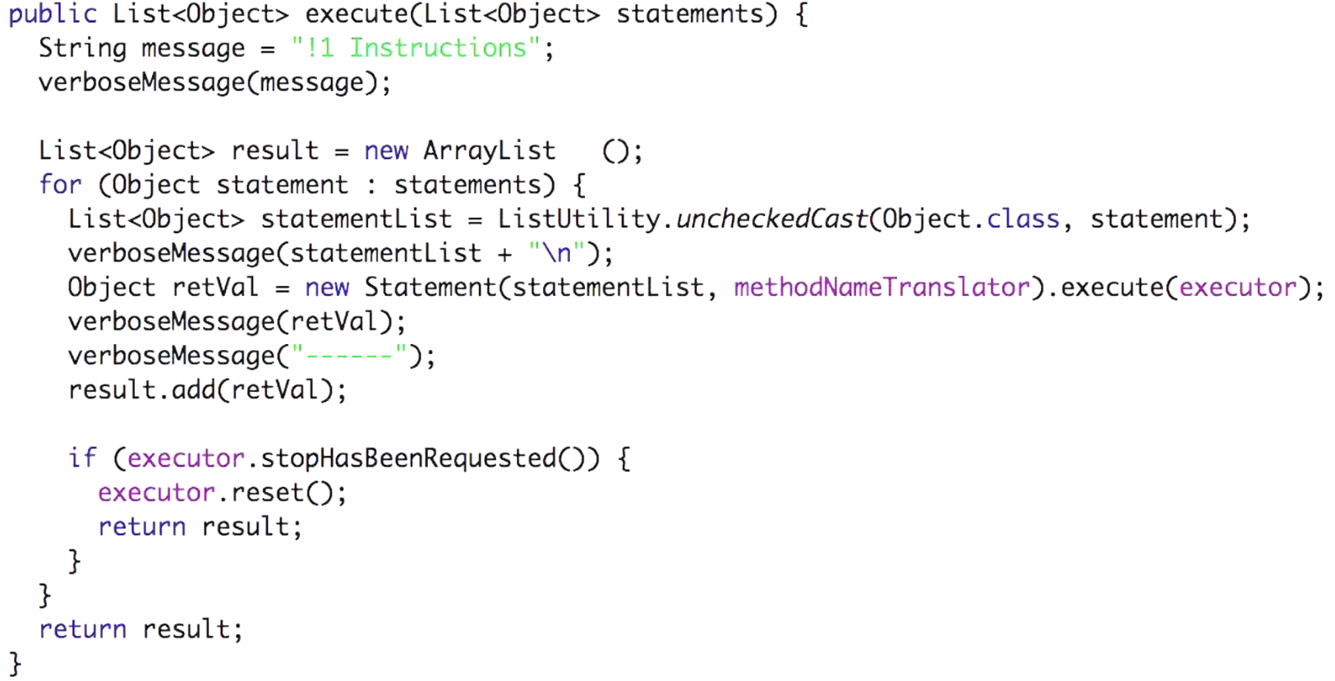
SRP Logging

Slide 20
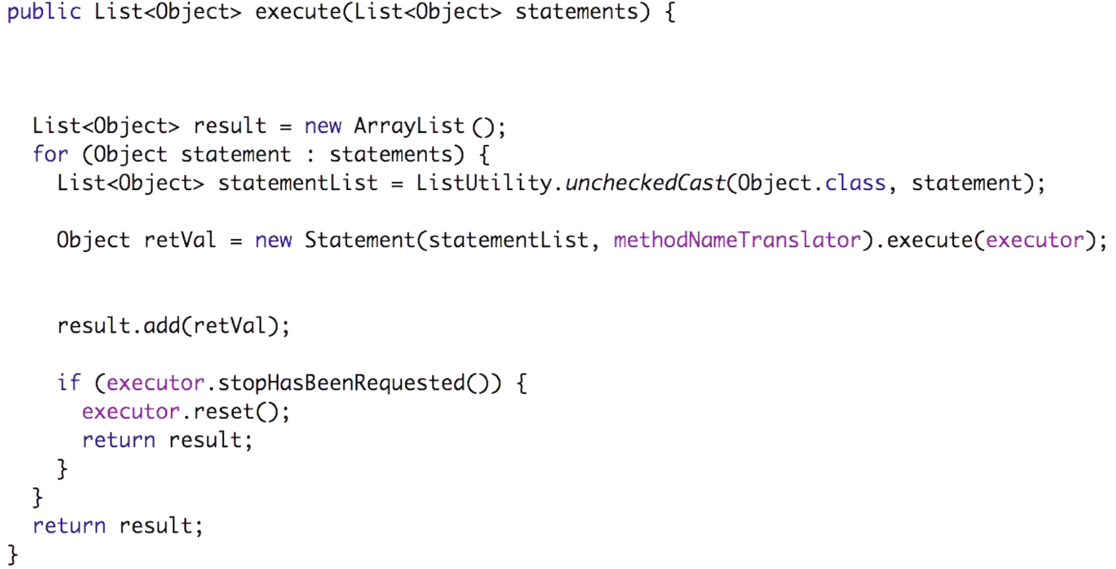
SRP Logging

Slide 21
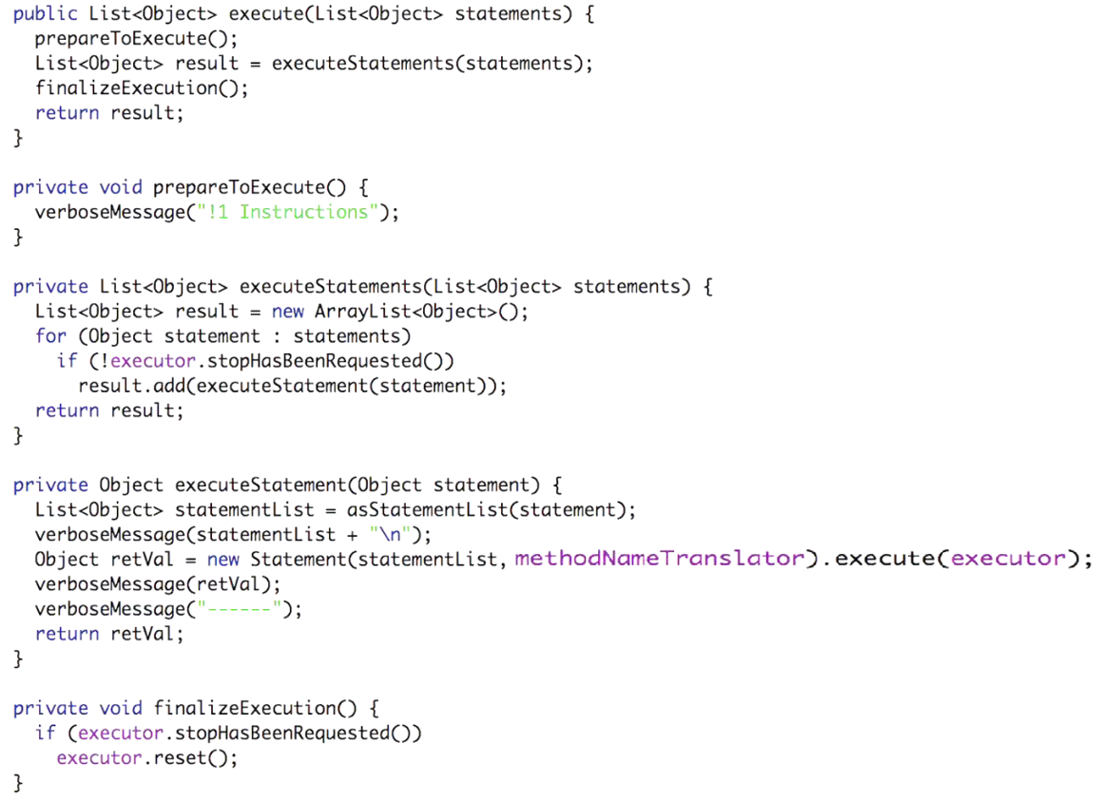
SRP Logging
Verbose statements are moved into functions that do only things related to what is being logged
Logging statements and logged code is separated from the code that is not being logged

Slide 22
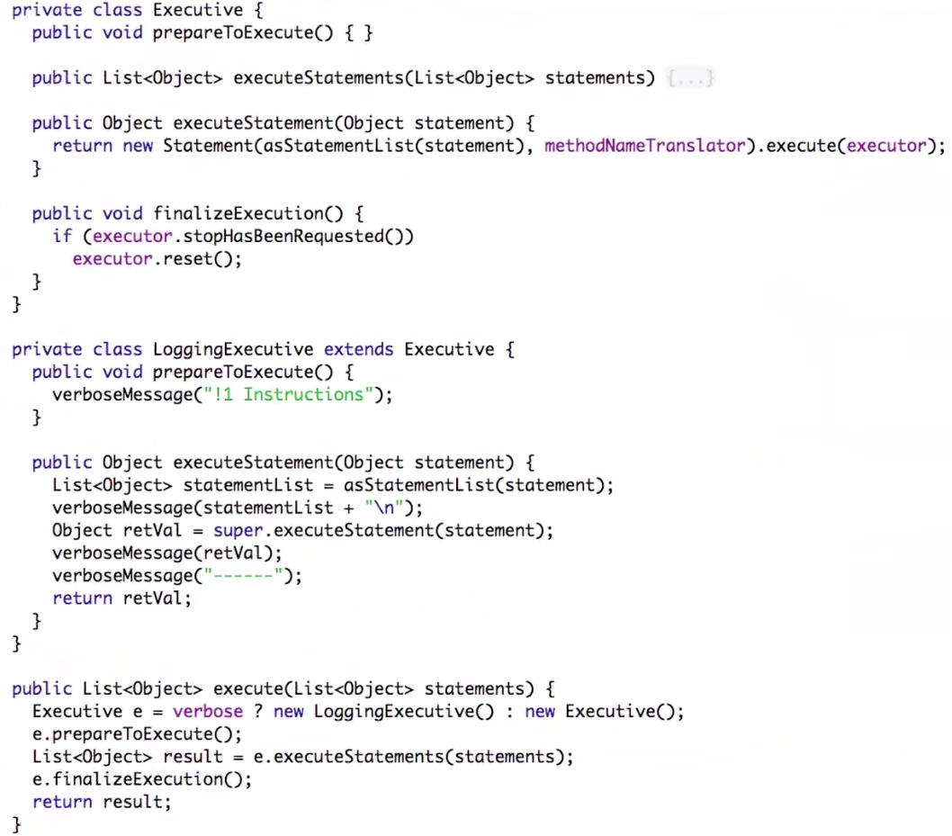
SRP Logging
After moving functions into classes and creating a base class that does not know how to log and derivative that does.
Derivative class does only logging and defers all other class to base class
In reality, this kind of separation may not be required because log messages don’t change that often
Separation into functions that we saw on previous slide is good enough
No need to have base class and derivative that knows about logging

Slide 23
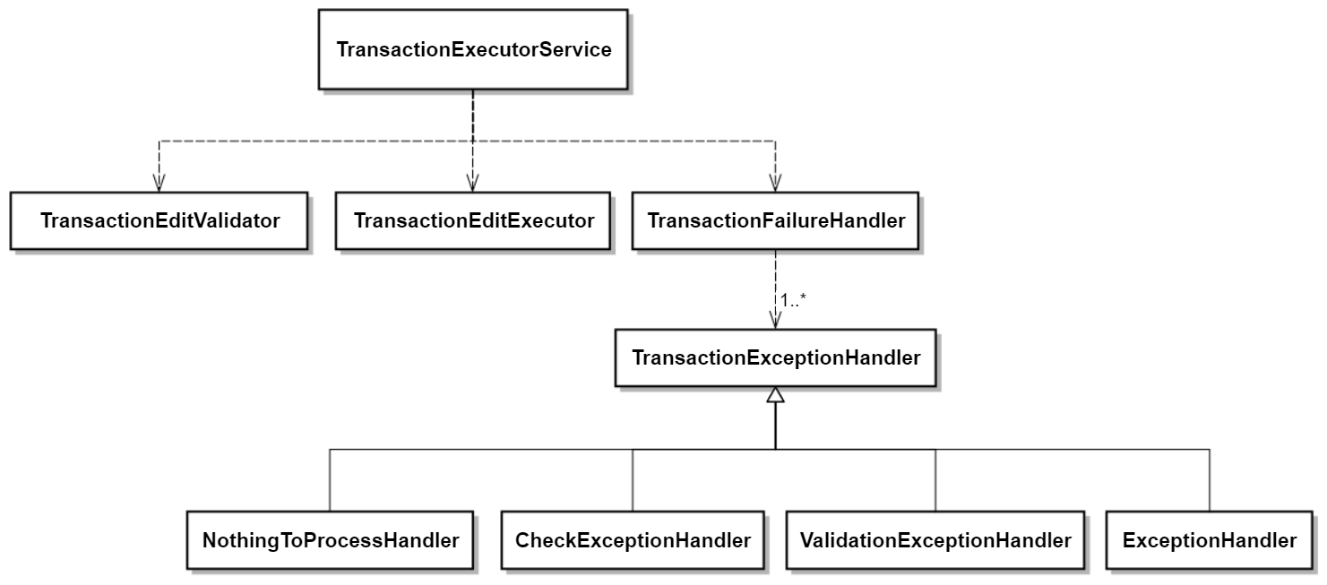
SRP - Transaction Executor Example
Timing Method invocation
Separating error handling

Slide 24
O – Open-Close Principle (OCP)
Software entities (classes, modules, functions, etc.) should be open for extension, but closed for modification.
How can a class be open for extension without modifying its source code?
Through Inheritance and polymorphism

Slide 25
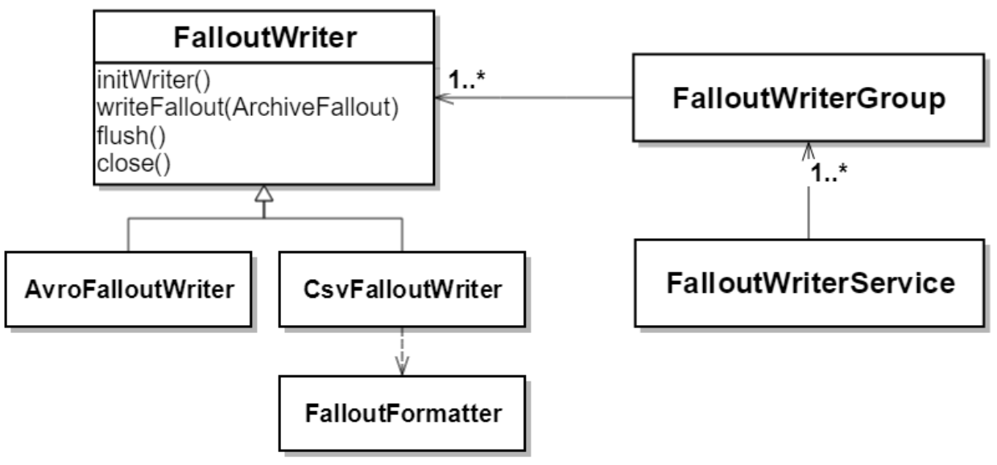
OCP – FalloutWriter example
How to introduce say JsonFalloutWriter or S3FalloutWriter without modifying any existing code with above design?

Slide 26
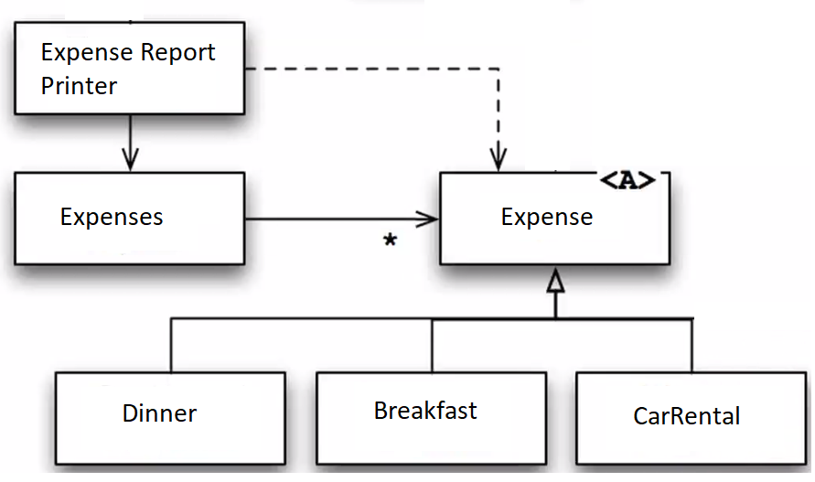
OCP – Expense example
We can introduce new Expense types without modifying existing code

Slide 27
OCP – The Lie
Let us say, User want to be able to tag any expense with different labels such as MEAL, TRAVEL, TRAINING, etc.
Or while printing Expense, User wants to have an indication that a expense was done on a weekend.
How can we add this requirement without changing any existing code of Expense Report example?
OCP only helps us to incorporate changes that we can predict.
We cannot have a design which allows us to arbitrarily incorporate any new user requirement.

Slide 28
OCP – The Lie – What’s the solution?
Predict the future with a crystal ball?
Big Design Up Front (BDUF)
Think really hard and carefully consider customer and problem domain
Create Domain model that anticipates customer’s needs
Create abstractions around the anticipated changes
Do this until you have thought of everything
This can lead to very complex design that is hard to understand & maintain. Customer may come up with something that you did not think about.

Slide 29
OCP – The Lie – What’s the solution?
Agile Design
Do simplest thing you can and show it to customer
Customer then starts shooting at you with change requests
Once you know what changes are likely then you can refactor and use OCP to shield your code for that kind of change
And then repeat from top

Slide 30
L – Liskov Substitution Principle (LSP)
If S is a subtype of T then all the places where T is used, if S is used; that should not change behavior of caller program.
Subtypes must be substitutable for their base types without altering the behavior of the caller program
Goes hand in hand with Open-Close Principal
A violation of LSP is a latent violation of OCP
Must be carefully followed to adhere to OCP

Slide 31
LSP
When super class does something then sub-class must do it too. And do it in a way that does not violate expectations of callers.
Subtype can do more but cannot do less.
LSP is violated when sub-class overrides a method of super class and
Does nothing OR
Throws RuntimeException unconditionally

Slide 32
LSP - Example
Rectangle and Square Example
FalloutWriter example

Slide 33
I – Interface Segregation Principle (ISP)
Clients (of a class/interface) should not be forced to depend on methods that they do not use
Instead of having one interface with lots of methods in it, we should have smaller and focused interfaces.
ISP helps us to prevent unwanted dependencies on things that client does not need.
Goes hand in hand with LSP

Slide 34
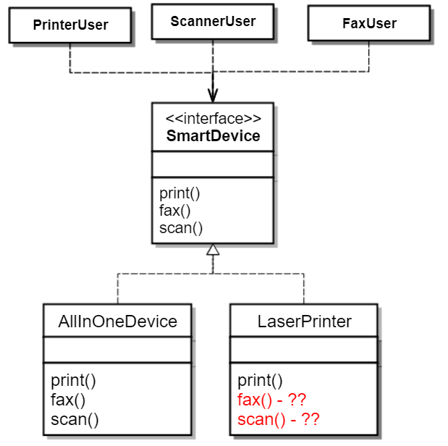
ISP - Example
SmartDevice is a fat interface leading to fat class “AllInOnceDevice”
Different users of SmartDevice use only certain methods from it but still they depend on all its methods.
Any change in SmartDevice and all its users have to be recompiled.
Printer device cannot implement fax() and scan().
It violates LSP as well as OCP.

Slide 35
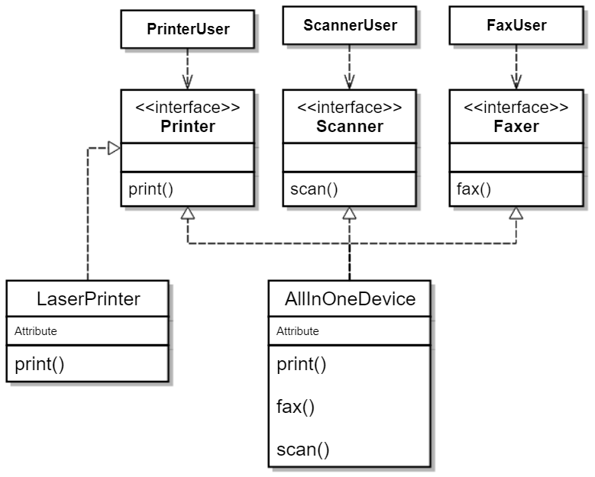
ISP - Example
Small interfaces with specific methods
These are called Role interfaces
LaserPrinter implements only the relevant interface

Slide 36
ISP – Role Interfaces
Consider a JIRA like application where we want to track progress of tasks and the dependencies of tasks on each other.
Each task has a duration (in days), it would take for that task to be completed.
Each task can have a set of predecessor and a set of successors tasks.
With this we can figure out earliestStart, earliestFinish, latestStart and latestFinish of a task.

Slide 37
ISP - Example
Geocoder example
PlacesMatcher example

Slide 38
ISP in Dynamic typed languages
No interface exists in Python or Ruby
Does ISP apply then for these languages still?
Yes, it does because ISP is all about:
“Don’t depend on things you don’t need.”

Slide 39
ISP violations
If you had to create instance of an object and passed in constructor arguments that you have no use for?
FileWriter vs FileAppender
If you had to build a complex data structure simply to run an unit test?
If you had to fire up webserver or connect to DB to debug/test a business rule?
If you wanted to call a function but you had to call other two functions before you can call the function you want?

Slide 40
ISP
“Don’t depend on things you don’t need.”
ISP is all about the “Need to know”

Slide 41
D – Dependency Inversion Principle (DIP)
High-level modules should not depend on low-level modules. Both should depend on abstractions.
Abstractions should not depend on details. Details should depend upon abstractions.
By depending on a concept instead of on an implementation, you reduce the need for change at caller side.

Slide 42
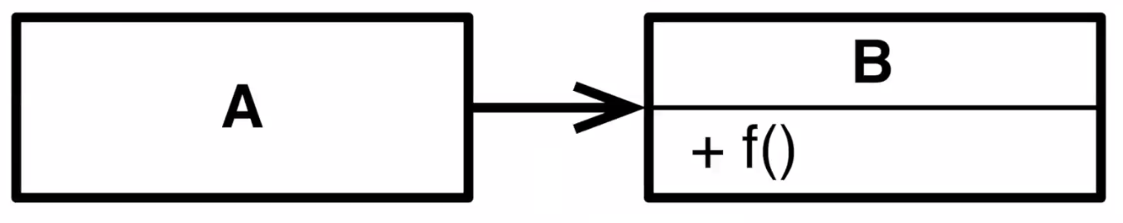
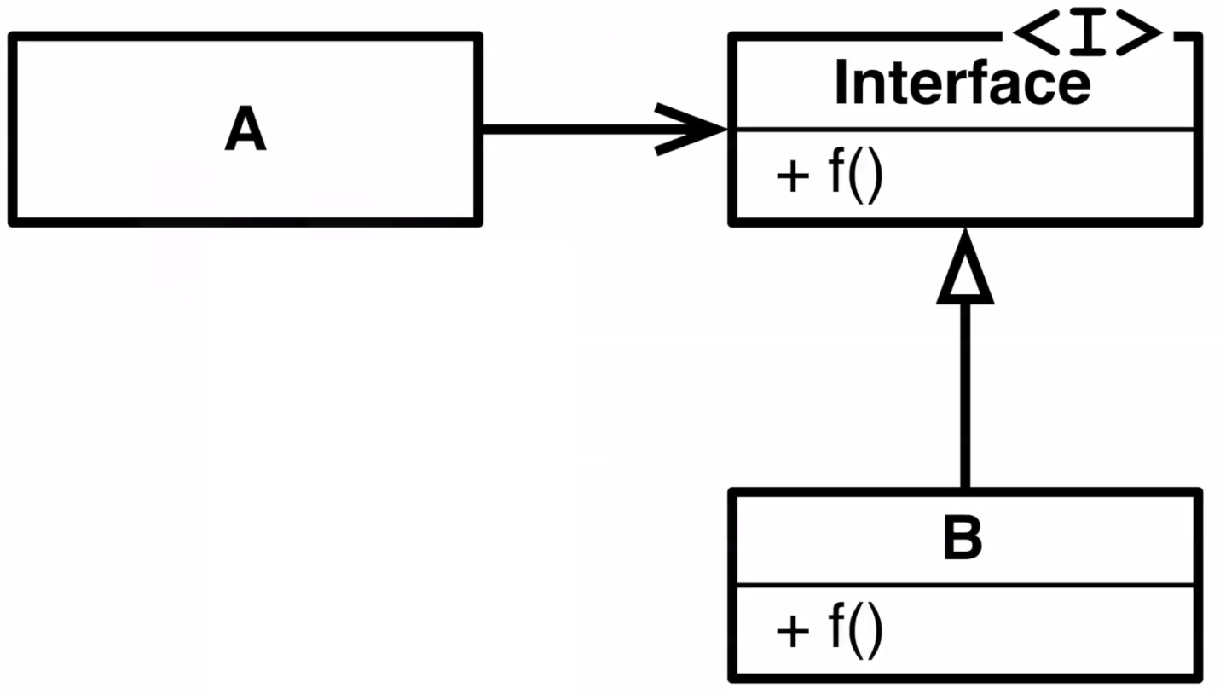
D – Dependency Inversion Principle (DIP)
Two types of dependencies
Compile time or Source code dependency
Runtime dependency
“A” still has runtime dependency on “B” but does not have compile time dependency on “B”.
Both “A” and “B” depend on abstraction (interface).
Dependency of “B” upon Interface points to in the opposite direction of runtime dependency of “A” upon “B”.
Compile time dependencies oppose the direction of flow of control. This is Dependency Inversion.

Slide 43
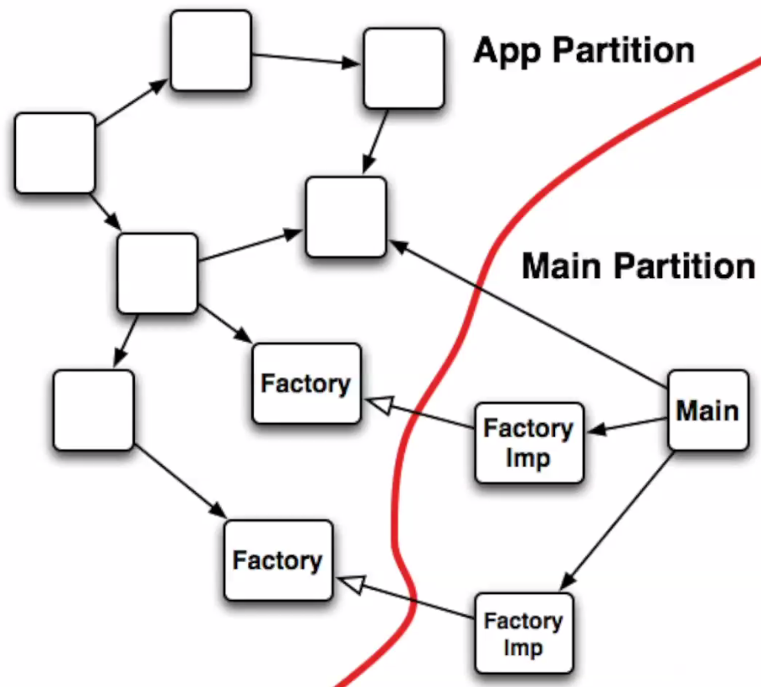
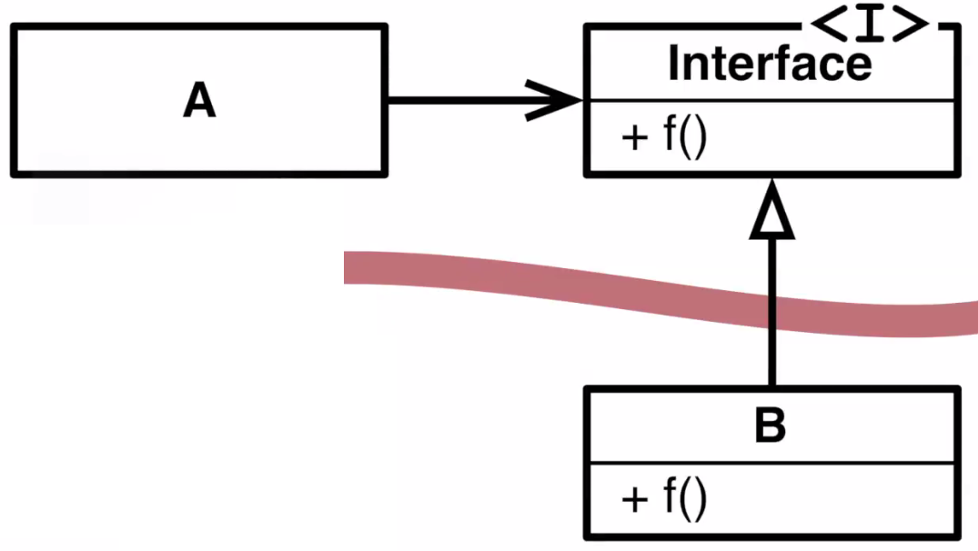
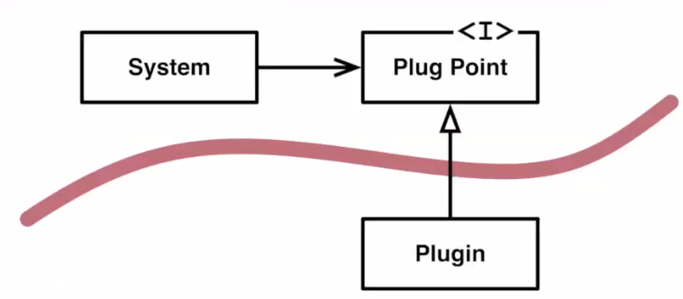
DIP - Boundaries
By inverting dependencies, we create boundaries between software modules.
All the dependencies should point in the same direction across the boundary.

Slide 44
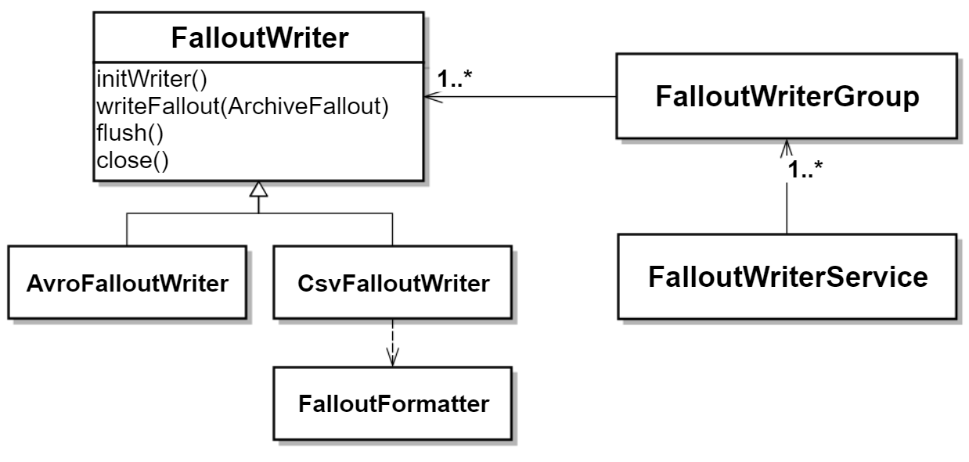
DIP - Boundaries
Can you find the boundary?

Slide 45
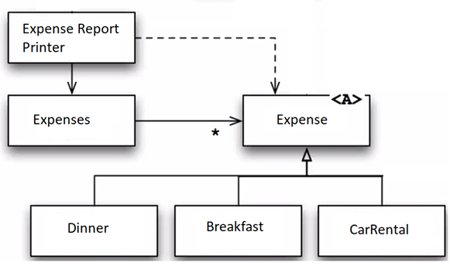
DIP - Boundaries
Can you find the boundary?

Slide 46

DIP - Boundaries
Can you find the boundary?

Slide 47
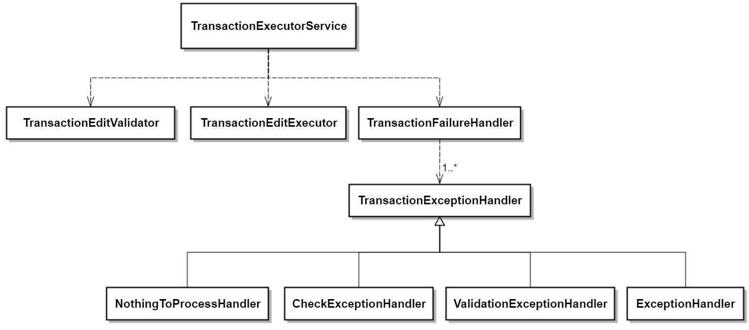
DIP - Boundaries
Can you find the boundary?

Slide 48
Law of Demeter (Tell Don’t Ask)
Law of Demeter for functions requires that a method m of an object O may only invoke the methods of the following kinds of objects:
O itself
m's parameters
Any objects created/instantiated within m
O's direct component objects
A global variable, accessible by O, in the scope of m
In particular, an object should avoid invoking methods on an object returned by another method.
The law can be stated simply as "use only one dot". That is, the code a.b.Method() breaks the law where a.Method() does not.
As an analogy, when one wants a dog to walk, one does not command the dog's legs to walk directly; instead one commands the dog which then commands its own legs.

Slide 49
Law of Demeter (Tell Don’t Ask)
Let us say you walk into a store and grap few items of the shelf.
Then you walk to the checkout counter and clerk at the counter tells you that the total price you have to pay is Rs. 450.
What do you do now?
Do you give the clerk your wallet and let him retrieve Rs. 450 from it?
Or Do you give the clerk Rs 450 yourself?

Slide 50
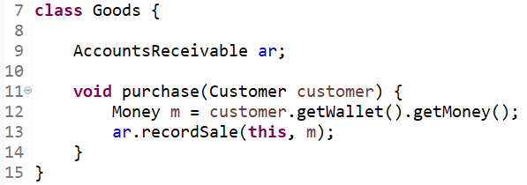
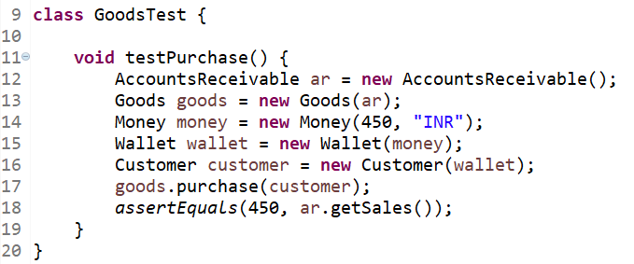
Law of Demeter (Tell Don’t Ask)
purchase() method has to ask Customer to getWallet() then it has to ask wallet to getMoney().
The test has so much boiler plate code because of violation of Law Of Demeter.
Test has to create Money then put that into Wallet and then put that Wallet into Customer and pass Customer to purchase().

Slide 51
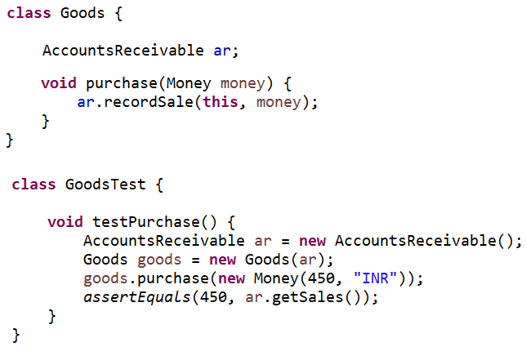
Law of Demeter (Tell Don’t Ask)
Instead of passing Customer object to purchase() method, we send only Money object.
That’s the only thing purchase() method needs.
It does not care who is purchasing the Goods.
Can you spot which of the SOLID principals this corresponds to?
Don’t depend on things you don’t need (ISP)
This is also called as “Principal of Least Knowledge”

Slide 52
DRY – Do not Repeat Yourself
Every piece of knowledge must have a single, unambiguous, authoritative representation within a system.
Any code written and used within your component should exist in only one location.
When you find yourself writing code (or copy/pasting) that is similar to something you've written before, refactor the code into reusable pieces and don't repeat yourself.
FalloutWriter.initializeWriters(), writeAndClearFallouts(), readableFileLines(), getLatitudeOfPoi(), getLongitudeOfPoi()
When software modules are not DRY they are called WET
Write Everything Twice
We Enjoy Typing
Waste Everyone’s Time

Slide 53
YAGNI – You Ain’t Gonna Need It
Do the simplest thing that could possibly work.
Goes hand in hand with Agile Design vs the Big Design Up Front (BDUF) approach.
Most of us have used Hibernate. Hibernate allows us to switch to any database by simply changing configuration.
How many of you were part of a project where you had to change database and this feature of Hibernate actually was used?
Story of Gapfiller

Slide 54
Feedback & Questions?

